Slide 1
Conceptual Data Modeling using the ER model Diagram
Prof. Saed SAYAd
CS527

Slide 2
Overview
Phases of Database Design
Entity Relationship (ER) model
Enhanced Entity Relationship (EER) model

Slide 3
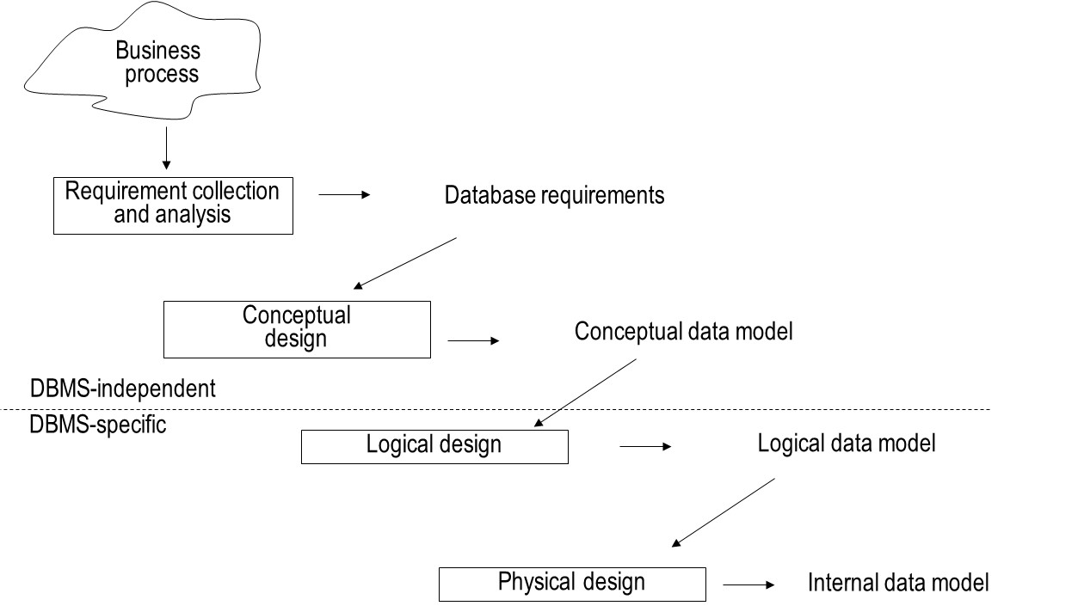
Phases of Database Design

Slide 4
Entity Relationship (ER) model
Entity Types
Attribute Types
Relationship Types
Weak Entity Types
Examples of the ER model
Limitations of the ER model

Slide 5
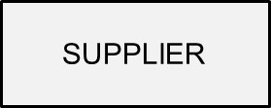

Entity Types
Entity type represents a business concept with an unambiguous meaning to a particular set of users
Examples: supplier, student, product or employee
Entity is one particular occurrence or instance of an entity type

Slide 6
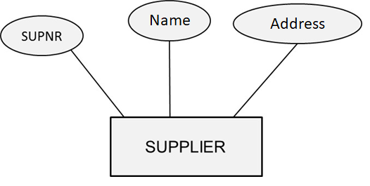
Attribute Types
Attribute type represents a property of an entity type.
Example: name and address are attribute types of the entity type supplier
Attribute is an instance of an attribute type
10 Downing St.

Slide 7
Example

Slide 8
Attribute Types
Domains
Key Attribute Types
Simple versus Composite Attribute Types
Single-Valued versus Multi-Valued Attribute Types
Derived Attribute Type

Slide 9
Attribute Type - Domains
A domain specifies the set of values that may be assigned to an attribute for each individual entity
Example: gender: male and female
A domain can also contain null values
null value: value is not known, not applicable or not relevant
Domains are not displayed in an ER model

Slide 10
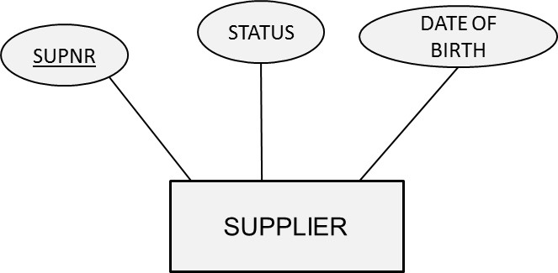
Key Attribute Types
A key attribute type is an attribute type whose values are distinct for each individual entity
Examples: supplier number, product number, social security number
A key attribute type can also be a combination of attribute types
Example: combination of flight number and departure date

Slide 11
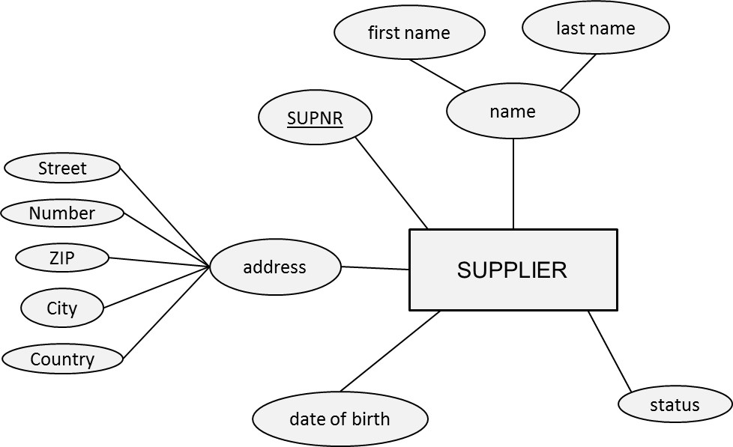
Simple versus Composite Attribute Types
A simple or atomic attribute type cannot be further divided into parts (e.g., supplier number, supplier status)
A composite attribute type is an attribute type that can be decomposed into other meaningful attribute types (e.g., address, name)

Slide 12
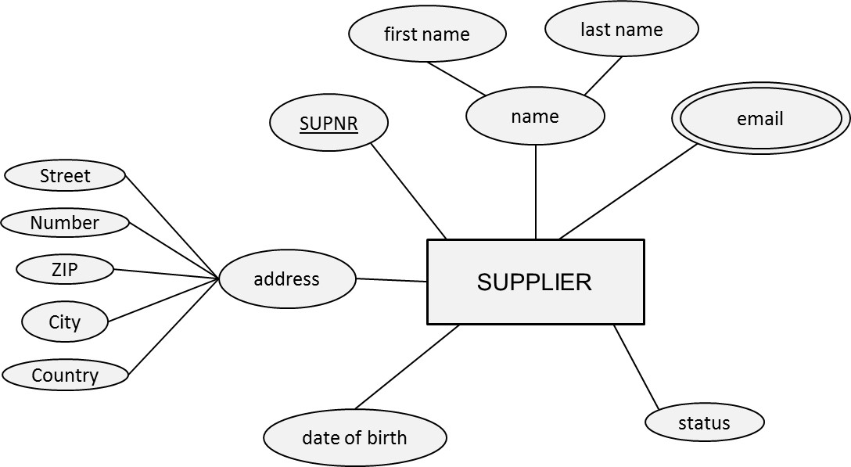
Single-Valued versus Multi-Valued Attribute Types
A single-valued attribute type has only one value for a particular entity (e.g., product number, product name)
A multi-valued attribute type is an attribute type that can have multiple values (e.g., email address)

Slide 13
Derived Attribute Type
A derived attribute type is an attribute type which can be derived from another attribute type (e.g., age)

Slide 14
Relationship Types
Definition
Degree and Roles
Cardinalities
Relationship Attribute Types

Slide 15
Definition
A relationship represents an association between two or more entities
A relationship type then defines a set of relationships among instances of one, two or more entity types

Slide 16
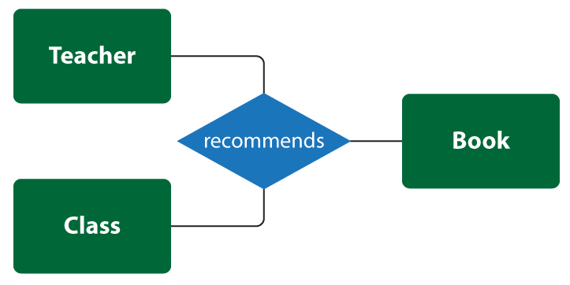
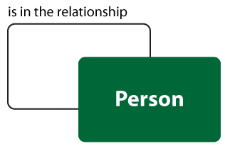

Degree and Roles
The degree of a relationship type corresponds to the number of entity types participating in the relationship type:
Unary: degree 1, binary: degree 2, ternary: degree 3
The roles of a relationship type indicate the various directions that can be used to interpret it. For example, a relationship "marriage" and its two roles "husband" and "wife". It has also become prevalent to name roles with phrases such as “is the owner of” and “is owned by”.
Unary
Binary
Ternary
both participants in the relationship are the same entity

Slide 17
Cardinalities
Every relationship type can be characterized in terms of its cardinalities, which specify the minimum or maximum number of relationship instances that an individual entity can participate in
Minimum cardinality can be 0 or 1
If 0: partial participation
If 1: total participation or existence dependency
Maximum cardinality can be 1 or N
3 options for binary relationship types: 1:1, 1:N, and M:N

Slide 18
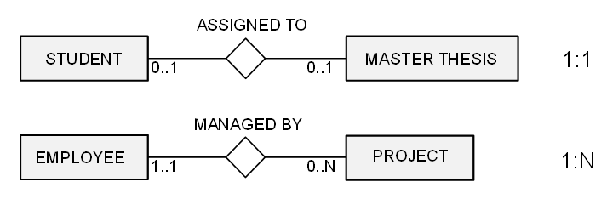
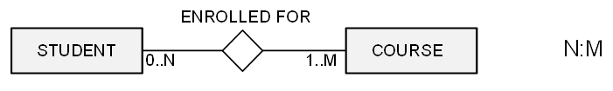
Cardinalities
One to One
One to Many
Many to Many

Slide 19
Participation Constraints
Participation Constraints represents how an entity is involved in the relation.
If all the entity values are participating in any relation, then it is called total participation.
If only few values of an entity is part of relation, then it is a partial participation.
For example, ‘Employee Works for a Department’. Here all the employees work for one or the other department. No employees are left without department. Hence all the employees are participating in this relation. Thus, participation of employee is total participation.
But individual Department will not have all the employees. Each department will have only few groups of employees working. Hence partial participation of department is seen here.

Slide 20
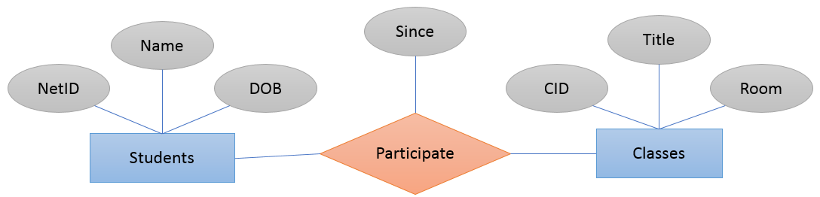
Relationship Attribute Types
Relationship type can also have attribute types
These attribute types can be migrated to one of the participating entity types in case of a 1:1 or 1:N relationship type

Slide 21
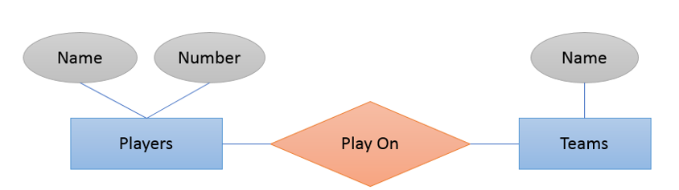
Weak Entity Type
A strong entity type is an entity type that has a key attribute type
A weak entity type is an entity type that does not have a key attribute type of its own
In a relational database, a weak entity is an entity that cannot be uniquely identified by its attributes alone; therefore, it must use a foreign key in conjunction with its attributes to create a primary key. The foreign key is typically a primary key of an entity it is related to.

Slide 22
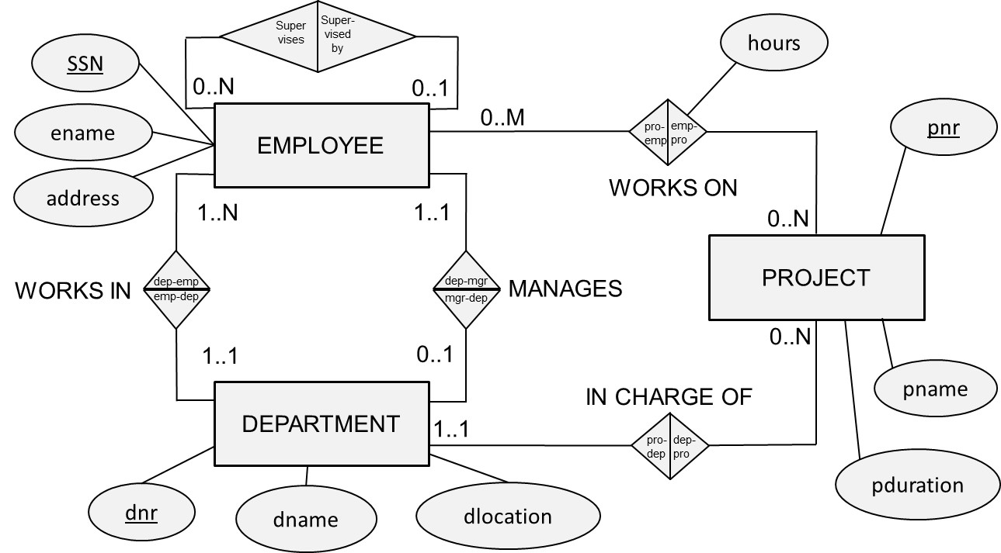
Examples of the ER Model

Slide 23
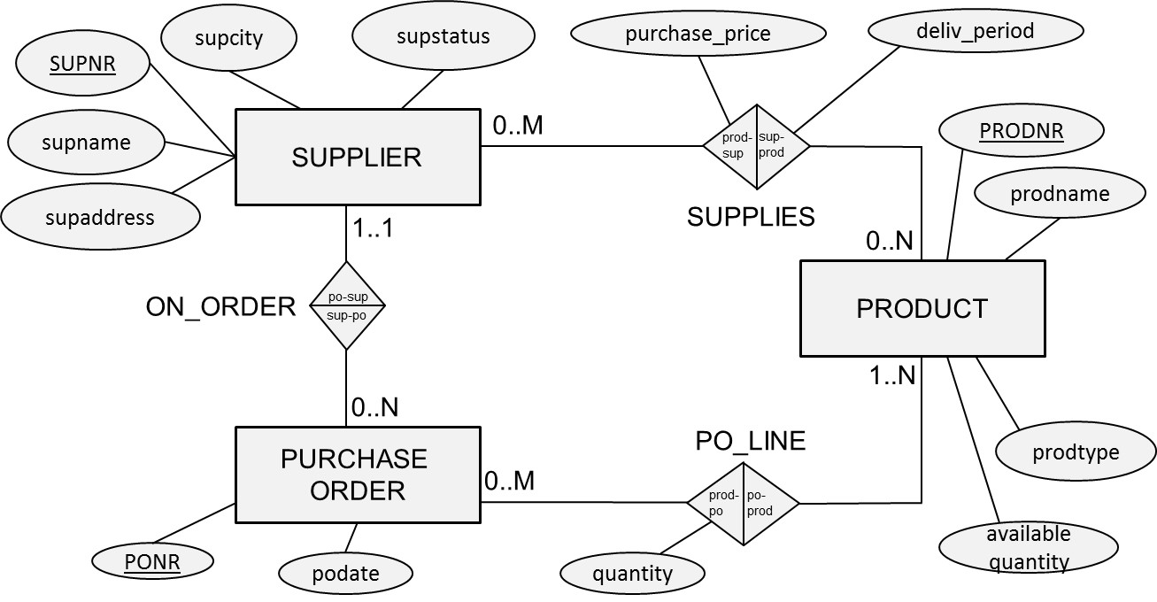
Examples of the ER Model

Slide 24
Designing the ER Model
Identify the entity types
Identify the relationship types and assert their degree
Assert the cardinality ratios and participation constraints (total versus partial participation)
Identify the attribute types and assert whether they are simple or composite, single or multiple valued, derived or not
Link each attribute type to an entity type or a relationship type
Denote the key attribute type(s) of each entity type
Identify the weak entity type(s) and their partial keys

Slide 25
Limitations of the ER model
Domains are not included in the ER model
Examples: hours should be positive; prodtype must be red, white or sparkling, supstatus is an integer between 0 and 100
Functions are not included in the ER model
Examples: calculate average number of projects an employee works on; determine which supplier charges the maximum price for a product
ER model cannot model temporal constraints
Example: a project needs to be assigned to a department after one month
ER model cannot guarantee the consistency across multiple relationship types
Example: suppliers can only be assigned to purchase orders for products they can supply

Slide 26
Enhanced Entity Relationship (EER) Model
Specialization
Generalization
Aggregation

Slide 27
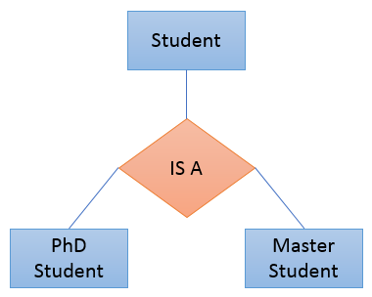
Specialization
Specialization (Top Down Approach) is the process of identifying subsets of an entity set (the superclass) that share some distinguishing characteristics.
Typically, the superclass is defined first, the subclasses are defined next, and subclass-specific attributes and relationship sets are then added.

Slide 28
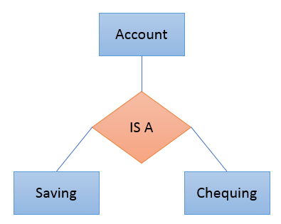
Generalization
Generalization (Bottom Up Approach) consists of identifying some common characteristics of a collection of entity sets and creating a new entity set that contains entities possessing these common characteristics.
Saving and Checking are generalized by Account.

Slide 29
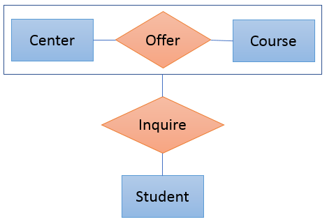
Aggregation
Aggregation is a process when relation between two entities is treated as a single entity. It allows us to indicate that a relationship set participates in another relationship set.

Slide 30
ERD
A database modeling tool for creating Entity Relationship Diagrams, Relational Schemas, Star Schemas, and SQL DDL statements.
https://erdplus.com/

Slide 31
Thank You!

